Slide 1
Autonomous Driving

Slide 2
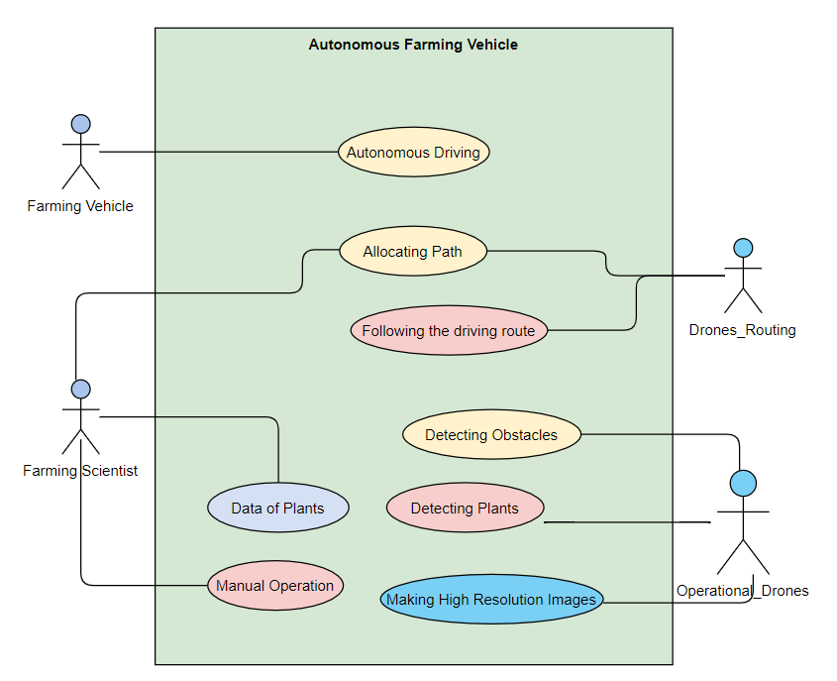
Use Case Diagram
Allocating Path to Farming Vehicles
Obstacle Avoidance
Using High Resolution Map Data from drones
Avoidance Manoeuvre by assessing which obstacle is present ( Sensor Data)
Harvest Operation

Slide 3
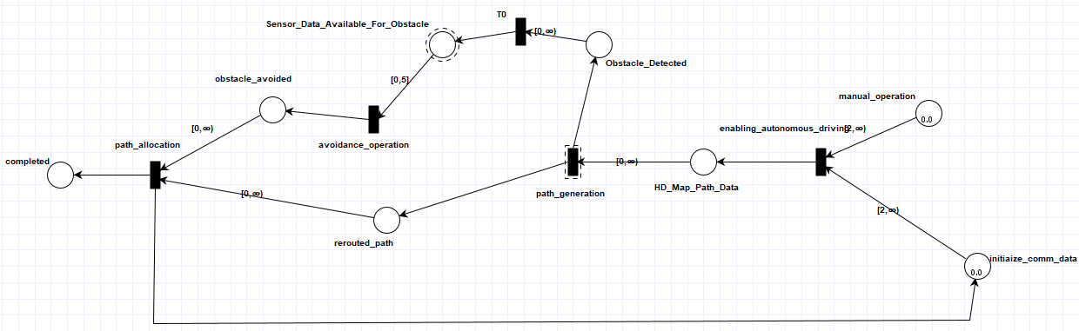
TAPAAL Implementation

Slide 4
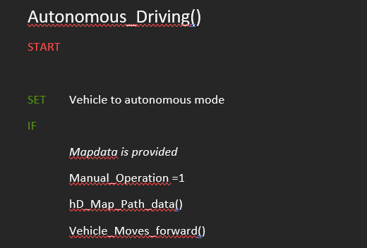
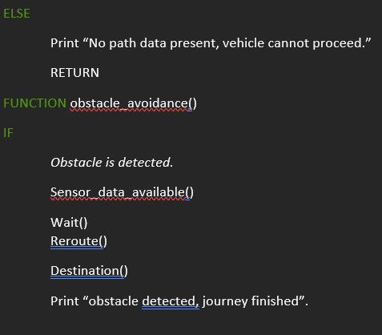
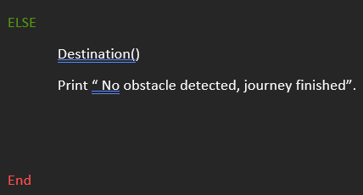
Pseudo Code

Slide 5
Data Building

